Slide 1

Order Fulfillment Portal
This is an online portal for centralized tracking of received order from various sources.

Slide 2
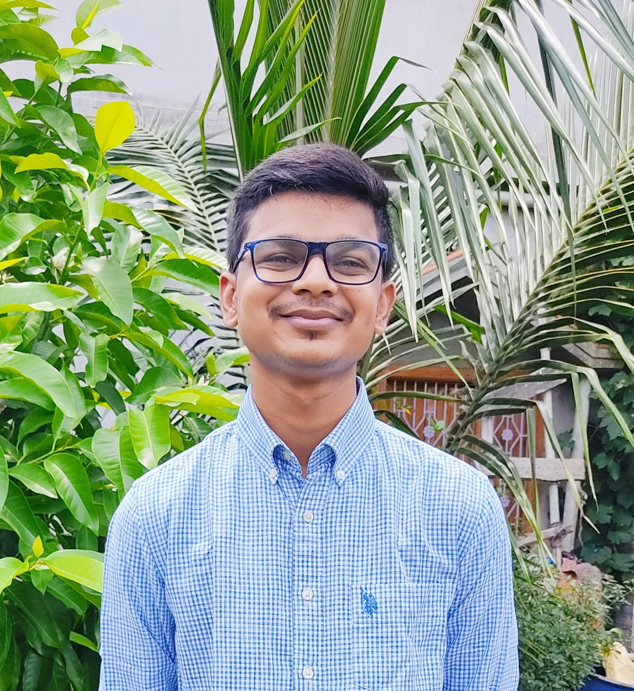

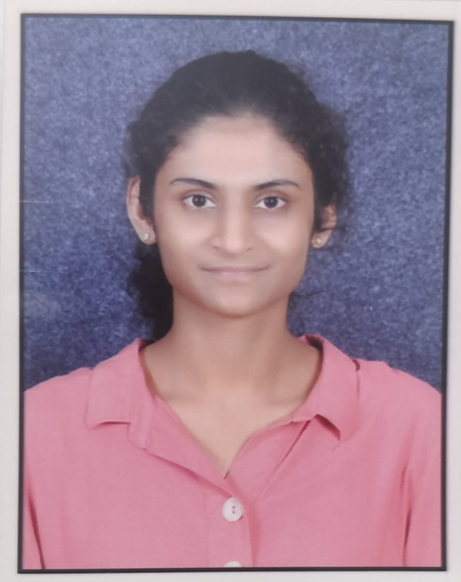
Team members
Gunjan Kumar
Goutham M
Raksha K N

Slide 3

Objective
To receive order in xml form.
To process the order request.
Store the order data in database.
Report on all orders placed.

Slide 4
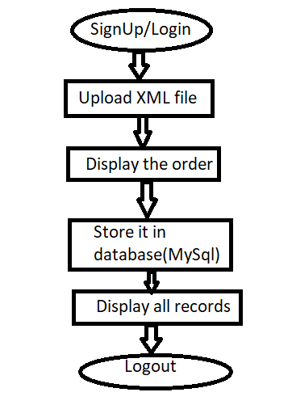
Presentation Layer
Employee can login/sign-up. For security we have used JWT authentication .
Once the employee is verified , they can upload the xml files, they can upload multiple files as well.
They can have a preview the uploaded file.
The data is then stored in the database.
Employees are provided with an option to all of the recorded data.
Once done with this they can logout

Slide 5
Business Logic layer
The portal provides us with the option to upload file, the file must be in xml format or else the file will be rejected.
Preview of the uploaded file is also available in the form of table.
Once the file is uploaded it is sent back to the backend where the file is once again validated and stored in the system , in our case we have saved the file D drive(D:).
XML file is converted into the POJO object by using the readValue() method of the XmlMapper class.
JPA generates the database schema using the POJO classes.
Once the data is stored in the database , we will be able to retrieve those data and view them as table.

Slide 6
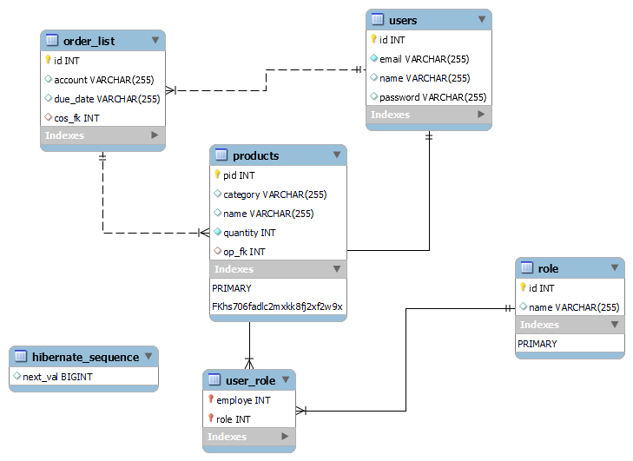
Data Layer
In total we have made 5 tables as shown in Fig1.
users :with fields id, email, name and password which are created during and sign-up and while logging in the values are compared for verification. It is in oneTomany mapping with order_list table.
user_role : with fields employee and role.
role: with fields id and name.
order_list : Created when the xml file is submitted, with fields id, account, due_date and is in oneTomany mapping with the products table. Since one order can have multiple products.
products :This is also created when the file is uploaded and has fields pid(product Id), name, category, quantity.
Fig1:Database Schema

Slide 7
Boundary Conditions
User name should be minimum of 4 characters and not empty.
Email should not be empty and should have the exact semantics of what makes up a valid email address according to Jakarta Bean Validation providers.
Password must not be empty and must contain a minimum of 3 characters and maximum of 10 characters.
While uploading the file, the file must be in .xml format.
File size threshold is 1KB.
File maximum size is 300MB.

Slide 8
Technologies
​
ReactJS (v16.18.0)
SpringBoot
JPA
MySql (Version 8.0)
DevTool
Axios
Reactstrap
Bootstrap
Jjwt(v0.9.1)

Slide 9
Highlighted Feature
Security.
Mutiple file upload.
Order and product in oneToMany relation , therefore capable on inputting many products for single order

Slide 10
Extra feature to add
Admin.
Option for deleting/cancelling order.
Tracking of order fulfillment in real-time.
Search option.

Slide 11
Testing of the code
Sl.No | Purpose | Test Case | Result
1. | Authentication | Valid email ,name and password | Successfully registered.
2. | Authentication | Invalid email ,valid name and password | Registration failed. Should use valid email
3. | Authentication | Valid email and password | Login successful.
4. | Authentication | Valid email but wrong password | Login unsuccessful.
5. | File Upload | Uploading .pdf file | File must be xml
6. | File Upload | Empty | Must contain file
7. | File Upload | Uploaded xml file | File successfully uploaded.

Slide 12
Lesson learnt
Technologies like react ,jwt
Planning
Team work
Time management
Software Design ,Analysis and Testing
Solving errors

Slide 13
THANK YOU

